Slide 1
Reentrant Lock

Slide 2
What is synchronization in Java?
Traditional way to achieve thread synchronization in Java is by the use of synchronized keyword.
Synchronized blocks don’t offer any mechanism of a waiting queue and once after the current running thread release the lock on shared resource, any thread can take the lock(Acquire the shared resource). This could lead to thread starvation of resources for some other thread for a very long period of time. Reentrant Locks are provided in Java to provide synchronization with greater flexibility.

Slide 3
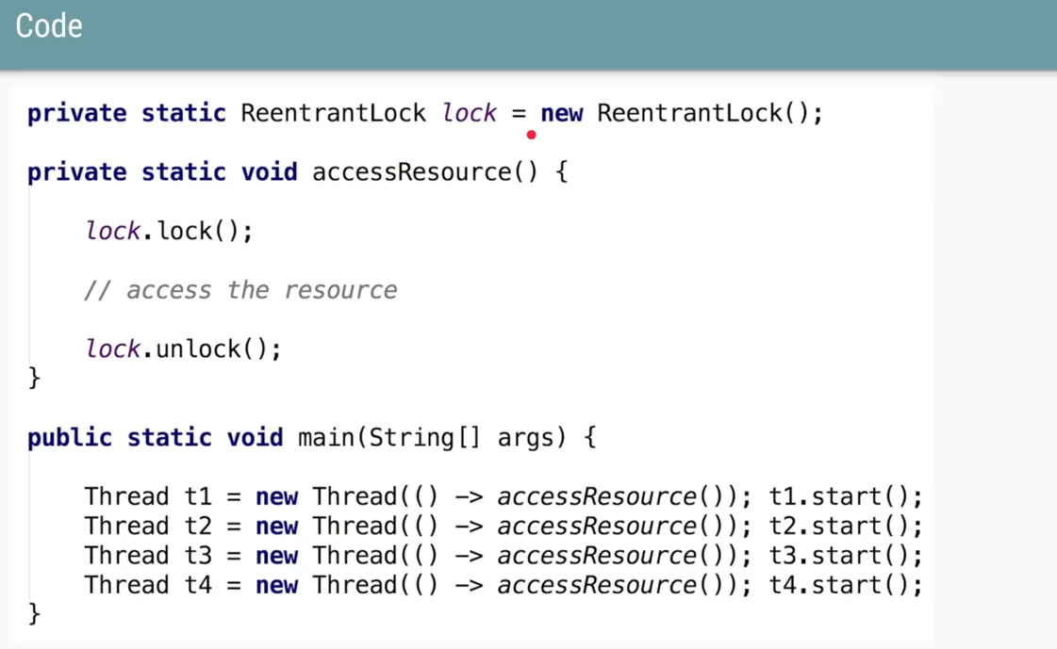
What is Reentrant Locks? And coding standards
The ReentrantLock class implements the Lock interface and provides synchronization to methods while accessing shared resources.
In ReentrantLock code looks like below to lock the shared resource is surrounded by lock and unlock method. This gives a lock to the current working thread and blocks all other threads which are trying to take a lock on the shared resource.

Slide 4
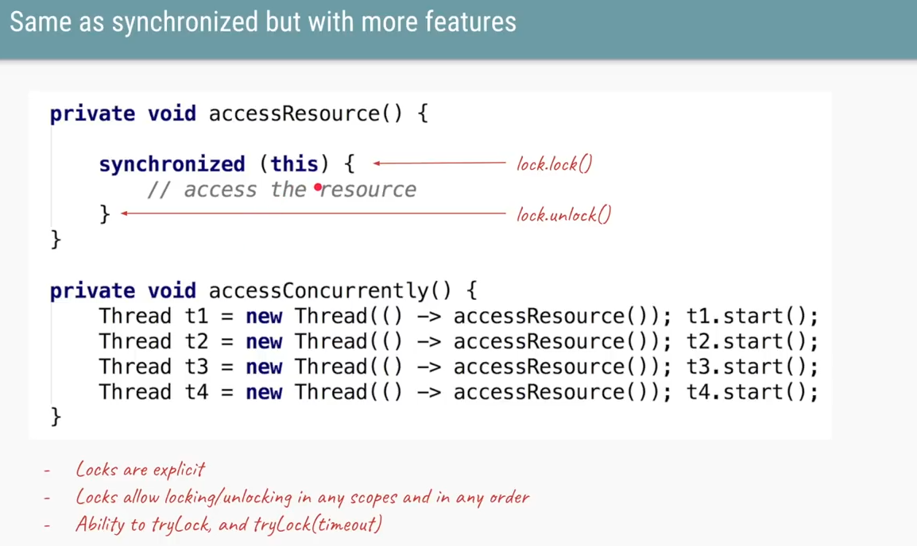
How this is similar to code of synchronized.
Reentrant Locks also offer a fairness parameter, by which the lock would abide by the order of the lock request i.e. after a thread unlocks the resource, the lock would go to the thread which has been waiting for the longest time to access the shared resource. This fairness mode is set up by passing true to the constructor of the lock.

Slide 5
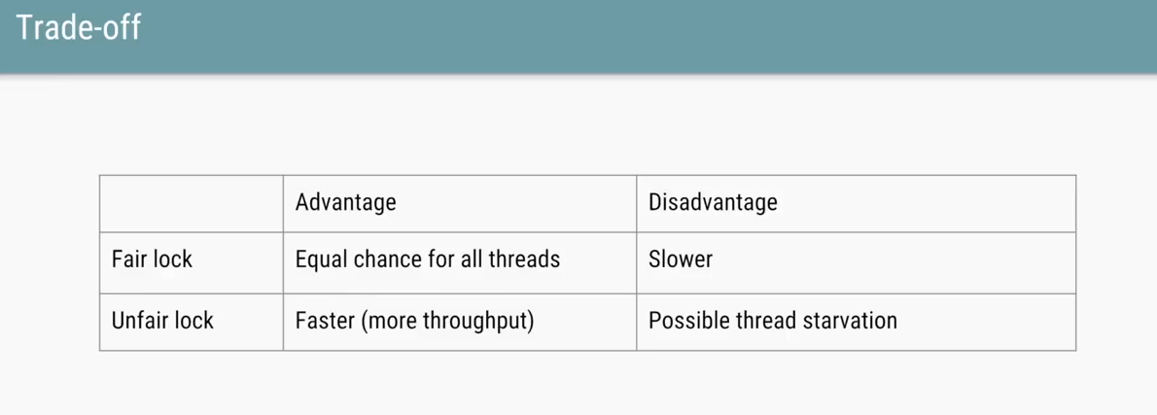

If do not setting anything (or) setting FALSE to constructor , then after a thread unlocks the resource, there is a possibility lock would go to the thread which is newly created and which is NOT waiting for the longest time to access the shared resource.
Behind the screen of fairness thread will be waiting in queue, where they will waiting to acquire the lock on Shared resource. After T1 releases the lock, then T2, then T3 and then T4 will go one by one to acquire the lock.

Slide 6
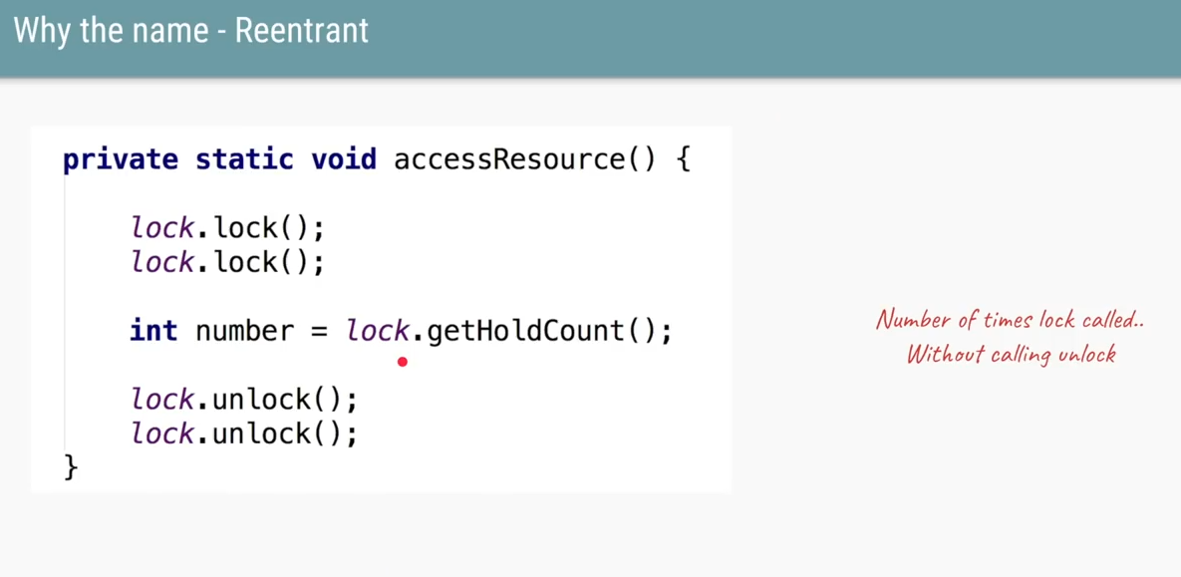
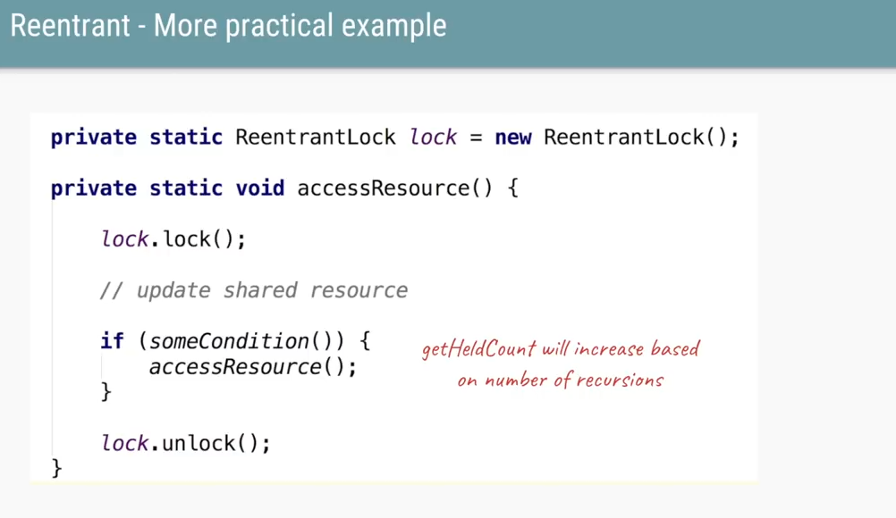
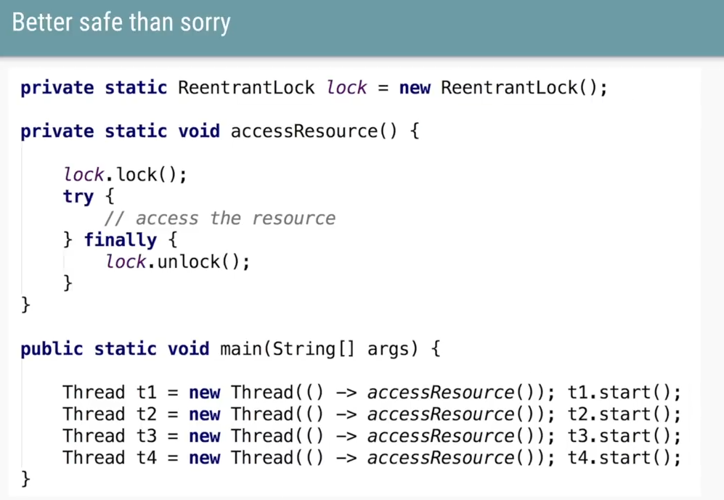
As the name says, ReentrantLock allows threads to enter into the lock on a resource more than once. When the thread first enters into the lock, a hold count is set to one. Before unlocking the thread can re-enter into lock again and every time hold count is incremented by one. For every unlocks request, hold count is decremented by one and when hold count is 0, the resource is unlocked.
Always don’t forget to unlock the resource and lock count should be equal to unlock count. If you forget to unlock, then the thread will never become runnable state again. Below is coding standard where unlock should be handled.

Slide 7
Methods of ReentrantLock()
lock(): Call to the lock() method increments the hold count by 1 and gives the lock to the thread if the shared resource is initially free.
unlock(): Call to the unlock() method decrements the hold count by 1. When this count reaches zero, the resource is released.
tryLock(): If the resource is not held by any other thread, then call to tryLock() returns true and the hold count is incremented by one. If the resource is not free, then the method returns false, and the thread is not blocked, but exits.
tryLock(long timeout, TimeUnit unit): As per the method, the thread waits for a certain time period as defined by arguments of the method to acquire the lock on the resource before exiting.
lockInterruptibly(): This method acquires the lock if the resource is free while allowing for the thread to be interrupted by some other thread while acquiring the resource. It means that if the current thread is waiting for the lock but some other thread requests the lock, then the current thread will be interrupted and return immediately without acquiring the lock.
getHoldCount(): This method returns the count of the number of locks held on the resource.
isHeldByCurrentThread(): This method returns true if the lock on the resource is held by the current thread.
getQueueLength(): Returns the count of thread waiting in Queue to acquire the lock.

Slide 8
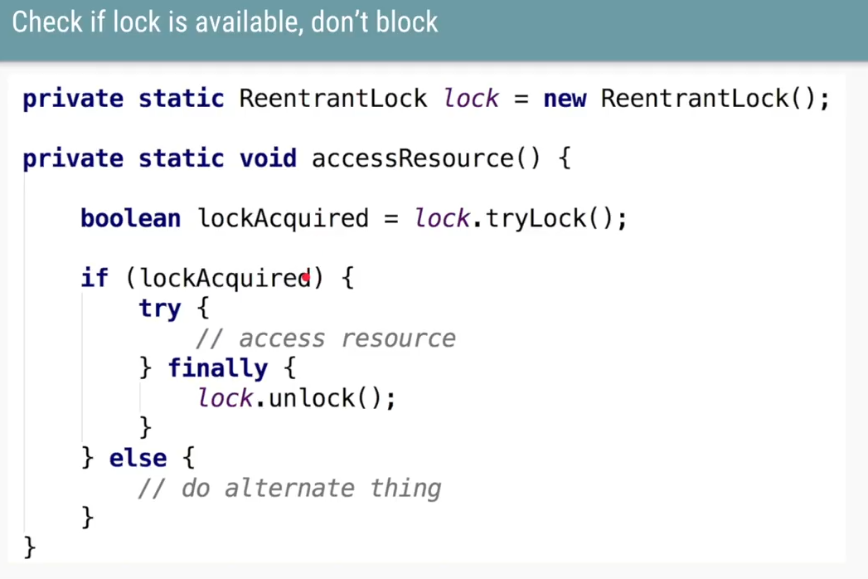
tryLock(): The name suggests try to acquire the lock and let me know if you acquired it.
This returns BOOLEAN and if it returns TRUE, then you have acquired the shared resource.
If it returns FALSE, then you have not acquired the shared resource please do not block (go to waiting state), then you want to do something else then below is the code looks like.

Slide 9
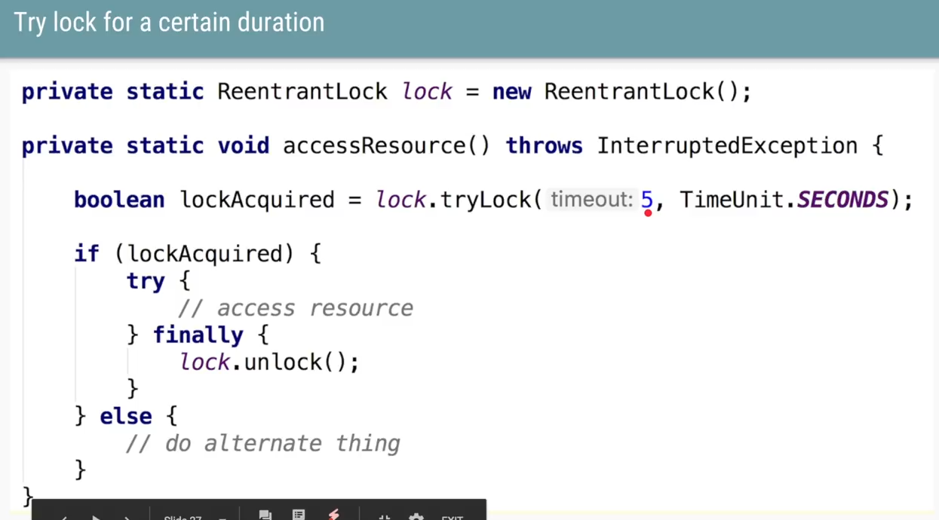
tryLock(long timeout, TimeUnit unit): try to acquire the lock (i.e) waiting for other thread who acquired the lock to release it. The waiting time will be input parameter that we pass in.

Slide 10
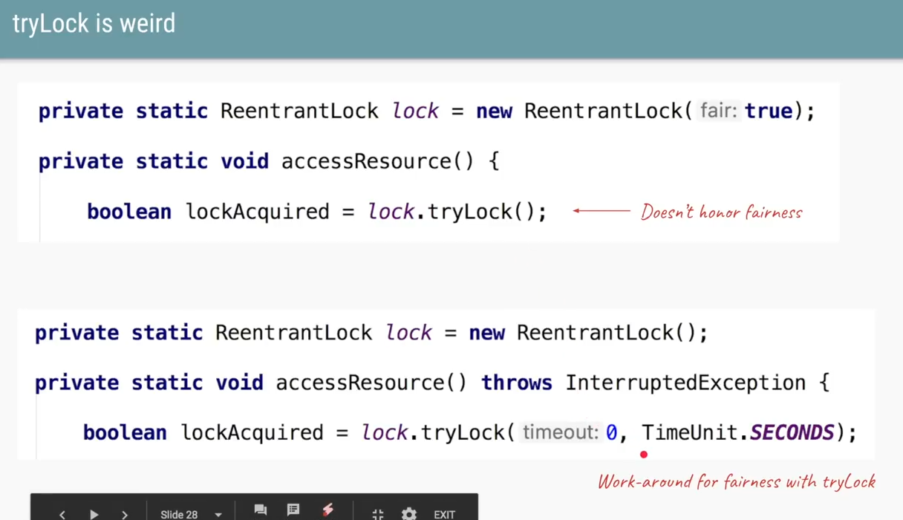
Fairness does NOT work on try and below is the work around

Slide 11
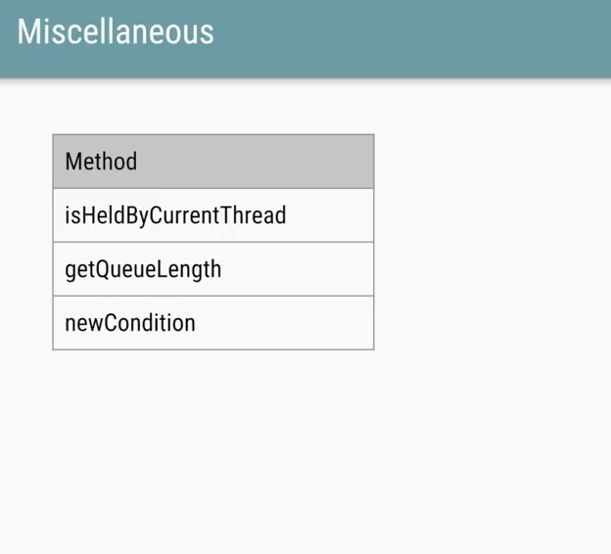
Methods of Reentrant Lock

